Slide 1


SQL PROJECT
FINANCE AND SUPPLY CHAIN ANALYTICS
PRESENTED BY
AKHILA

Slide 2
PROBLEM STATEMENT
AtliQ Hardware is having trouble managing its growing Excel files — they’ve become too big and slow. To address this issue, the company established a data analytics team to utilise MySQL and enhance data handling and business efficiency.
PROJECT OVERVIEW
The project focuses on analyzing AtliQ Hardware’s data to find useful insights. The main aim is to understand sales performance, market trends, customer behavior, and predict supply chain needs.

Slide 3
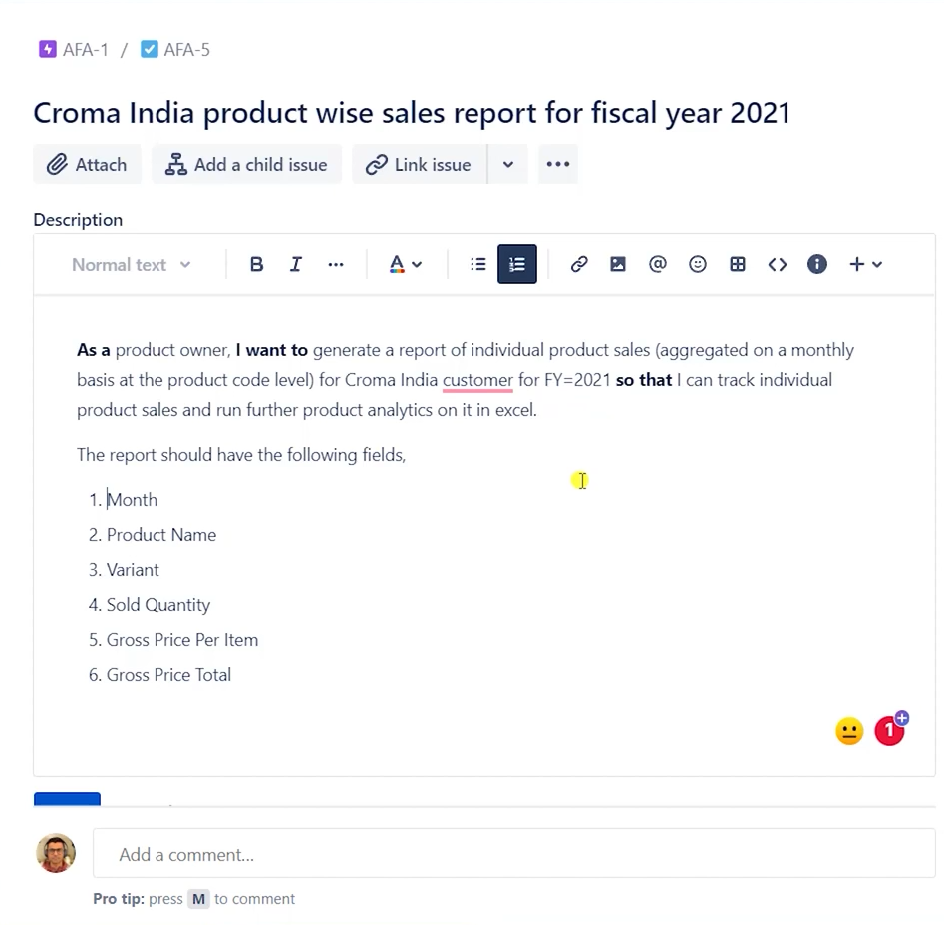
FINANCE ANALYTICS
TASK 1
Retrieves sales data for customer 90002002 (Croma) in fiscal year 2021, showing product name, variant, sold quantity, gross price, and total gross price.
Joins fact_sales_monthly, dim_product, and fact_gross_price tables using product_code and fiscal_year.
Uses the get_fiscal_year() function to extract the fiscal year from the sale date for accurate price matching.
Calculates Total_Gross_Price as (sold_quantity × gross_price).
Filters results by customer_code and fiscal_year, sorts by date (ascending), and limits output to 1,000,000 records.
Retrieves sales data for customer 90002002 in fiscal year 2021, showing product name, variant, sold quantity, gross price, and total gross price.
Joins fact_sales_monthly, dim_product, and fact_gross_price tables using product_code and fiscal_year.
Uses the get_fiscal_year() function to extract the fiscal year from the sale date for accurate price matching.
Calculates Total_Gross_Price as (sold_quantity × gross_price).
Filters results by customer_code and fiscal_year, sorts by date (ascending), and limits output to 1,000,000 records.

Slide 4
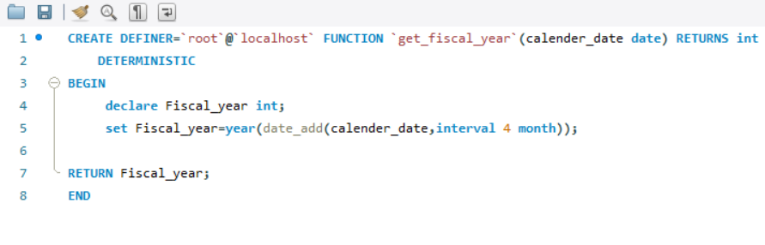
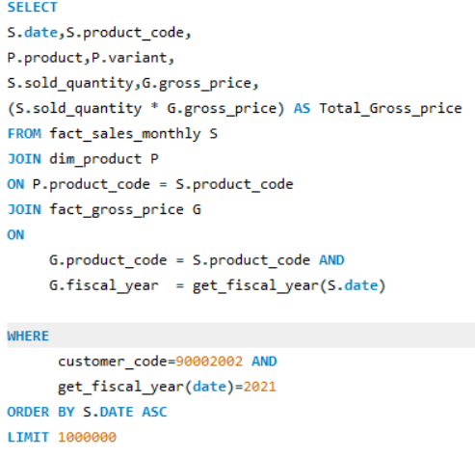
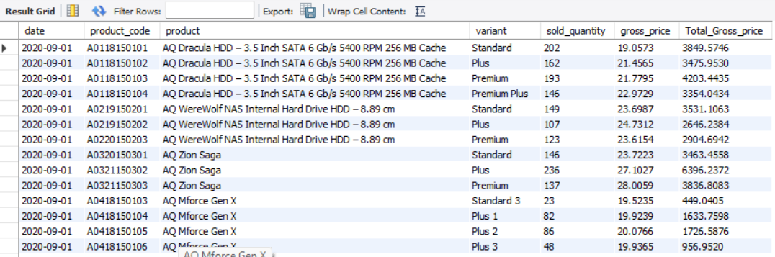
Solution pictures

Slide 5
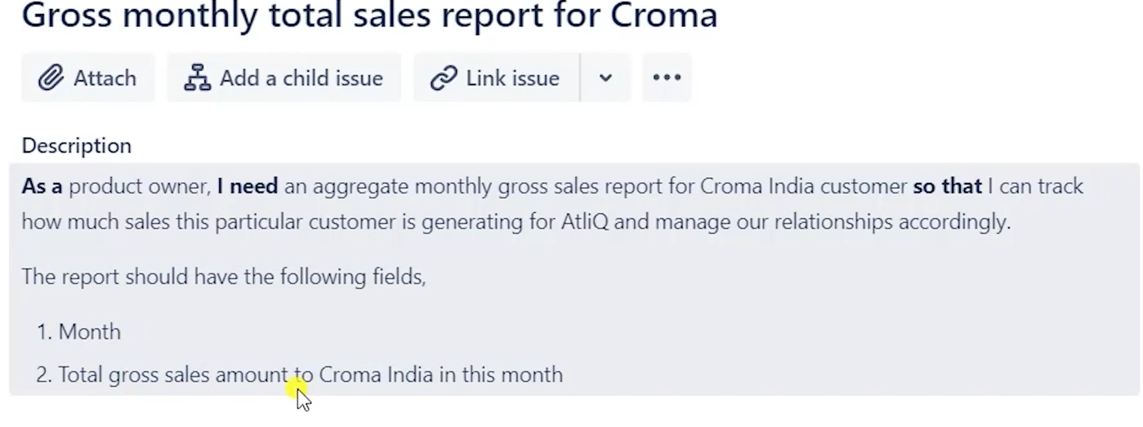
FINANCE ANALYTICS
TASK 2
Retrieves the total gross price per month for customer 90002002 (Croma) from the sales data.
Joins the fact_sales_monthly and fact_gross_price tables using product_code and fiscal_year.
Uses the get_fiscal_year() function to extract the fiscal year from the sale date to match price data correctly.
Calculates Total_Gross_Price as the sum of (sold_quantity × gross_price) for each month, rounded to 2 decimal places.
Groups the data by month (S.date) and sorts it in ascending order to show month-wise sales performance.
Retrieves sales data for customer 90002002 in fiscal year 2021, showing product name, variant, sold quantity, gross price, and total gross price.
Joins fact_sales_monthly, dim_product, and fact_gross_price tables using product_code and fiscal_year.
Uses the get_fiscal_year() function to extract the fiscal year from the sale date for accurate price matching.
Calculates Total_Gross_Price as (sold_quantity × gross_price).
Filters results by customer_code and fiscal_year, sorts by date (ascending), and limits output to 1,000,000 records.

Slide 6
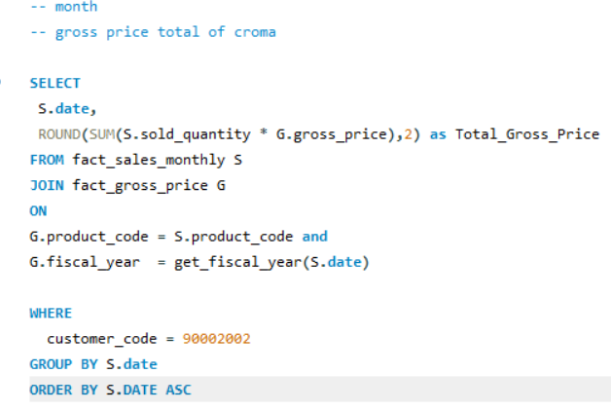
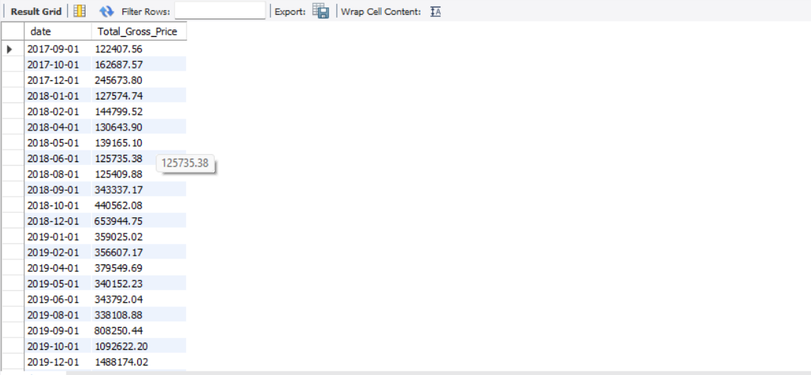
Solution pictures

Slide 7
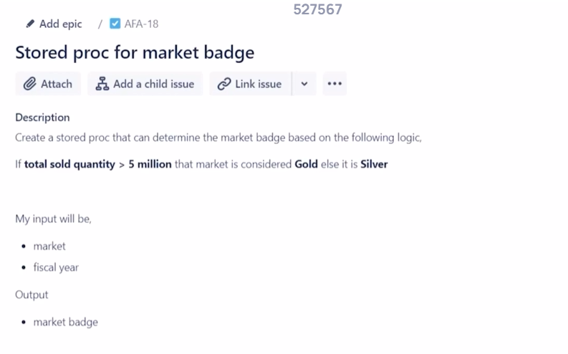
FINANCE ANALYTICS
TASK 3
Created A Stored Procedure to automate repeated tasks
Purpose:
  Determines whether a market earns a “Gold” or “Silver” badge based on total sold quantity in a specific fiscal year.
Inputs:
  in_market → Market name
  Fiscal_Year → Year for which sales are checked
  out_badge → Output variable that stores the result (Gold/Silver)
Logic:
  Calculates total sold quantity (qty) for the given market and fiscal year using a join between fact_sales_monthly and dim_customer.
Condition:
  If qty > 5,000,000, sets out_badge = "Gold"
  Otherwise, sets out_badge = "Silver".
Outcome:
  Returns a badge classification for each market based on its total sales performance.
Retrieves sales data for customer 90002002 in fiscal year 2021, showing product name, variant, sold quantity, gross price, and total gross price.
Joins fact_sales_monthly, dim_product, and fact_gross_price tables using product_code and fiscal_year.
Uses the get_fiscal_year() function to extract the fiscal year from the sale date for accurate price matching.
Calculates Total_Gross_Price as (sold_quantity × gross_price).
Filters results by customer_code and fiscal_year, sorts by date (ascending), and limits output to 1,000,000 records.

Slide 8
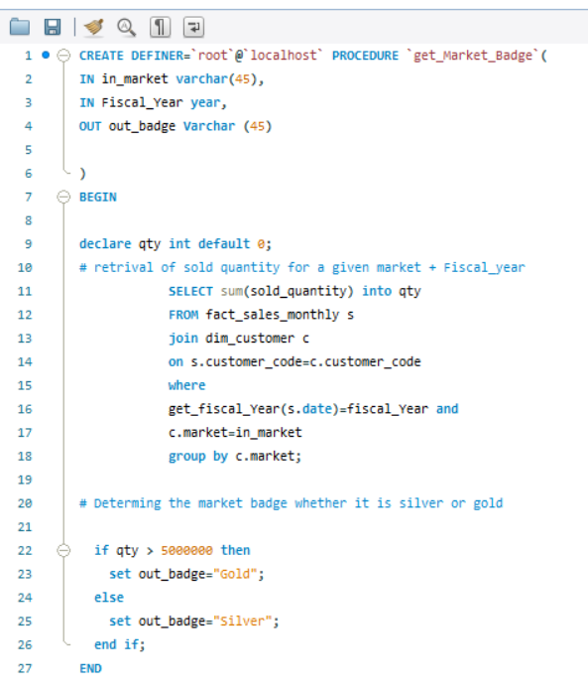
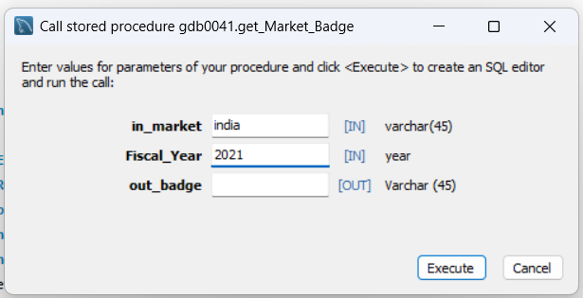
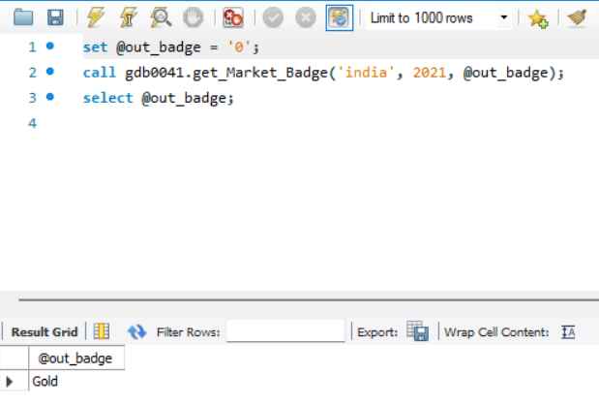
Solution pictures

Slide 9
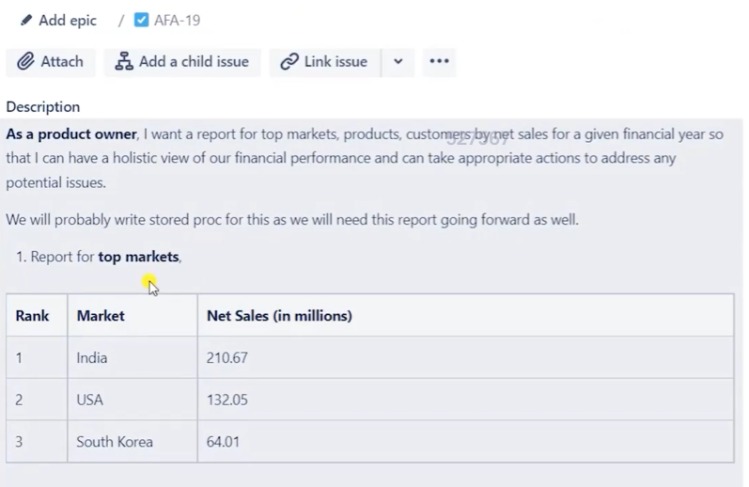
FINANCE ANALYTICS
TASK 4: TOP MARKETS
Created A Stored Procedure to automate repeated tasks
Initially, a view for Pre-Invoice Discounts was created to calculate Net Invoice Sales efficiently.
Using that view, another Post-Invoice Discounts view was developed.
From the Post-Invoice view, a Net Sales view was built to derive final sales figures..
These views were created to optimize query performance, since the direct table join for pre-invoice discount calculations took more than 6 seconds.
Finally, the Net Sales view was used to create this stored procedure to fetch the Top N performing Markets.
Logic
  Selects Market name and the sum of net sales from the net_sales view.
  Converts net sales into millions and rounds to 2 decimal places for readability.
  Filters records by the given fiscal year.
  Groups data by Market to calculate total sales per Market.
  Orders results in descending order of Net Sales.
  Limits the output to the Top N Markets as specified by the input parameter.
Retrieves sales data for customer 90002002 in fiscal year 2021, showing product name, variant, sold quantity, gross price, and total gross price.
Joins fact_sales_monthly, dim_product, and fact_gross_price tables using product_code and fiscal_year.
Uses the get_fiscal_year() function to extract the fiscal year from the sale date for accurate price matching.
Calculates Total_Gross_Price as (sold_quantity × gross_price).
Filters results by customer_code and fiscal_year, sorts by date (ascending), and limits output to 1,000,000 records.

Slide 10
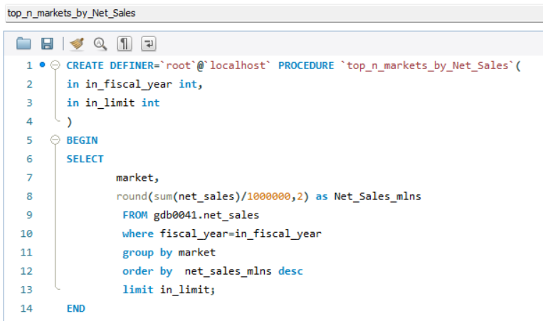
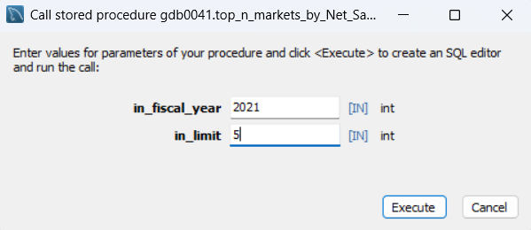
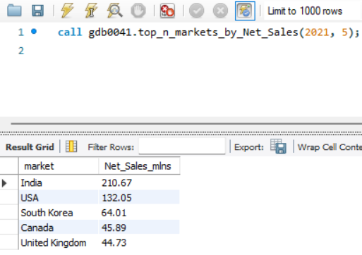
Solution pictures

Slide 11
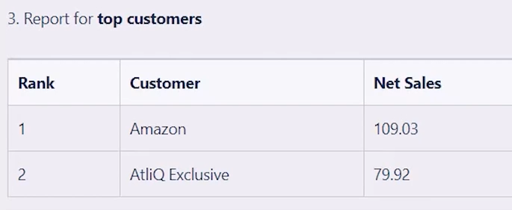
FINANCE ANALYTICS
TASK 4: TOP CUSTOMERS
Created A Stored Procedure to automate repeated tasks
Built after creating the Net Sales view, which was optimized using pre-invoice and post-invoice discount views to reduce query time.
This stored procedure helps analyze top-performing customers in a specific market and fiscal year, based on their Net Sales..
Purpose
  To display the Top N customers in a selected market and fiscal year, ranked by their Net Sales value.
Inputs
  in_market → Market name (e.g., India, USA, etc.)
  in_fiscal_year → Fiscal year to filter the data.
  in_top_N → Number of top customers to return
Logic
Selects customer name and total Net Sales from the net_sales view.
  Joins with the dim_customer table using customer_code to fetch customer details.Filters records by the given fiscal year.
  Filters records by the given market and fiscal year.
  Orders result in descending order of Net Sales.
  Limits the output to the Top N Customers as specified by the input parameter.
Output
  Displays the Top N customers for a chosen market and fiscal year, along with their Net Sales (in millions) — enabling quick market-wise performance analysis
Retrieves sales data for customer 90002002 in fiscal year 2021, showing product name, variant, sold quantity, gross price, and total gross price.
Joins fact_sales_monthly, dim_product, and fact_gross_price tables using product_code and fiscal_year.
Uses the get_fiscal_year() function to extract the fiscal year from the sale date for accurate price matching.
Calculates Total_Gross_Price as (sold_quantity × gross_price).
Filters results by customer_code and fiscal_year, sorts by date (ascending), and limits output to 1,000,000 records.

Slide 12
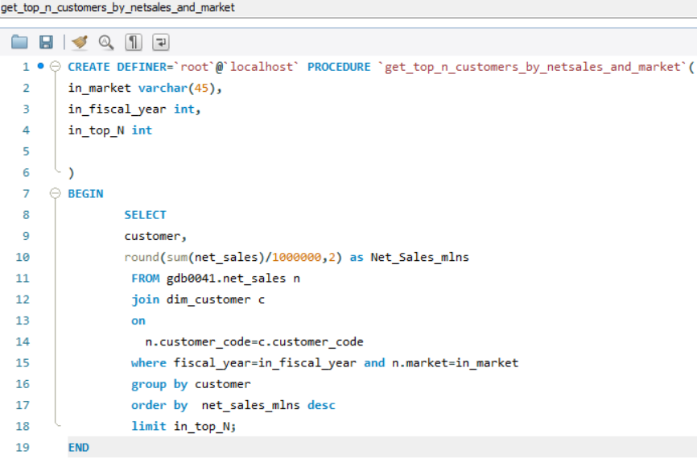
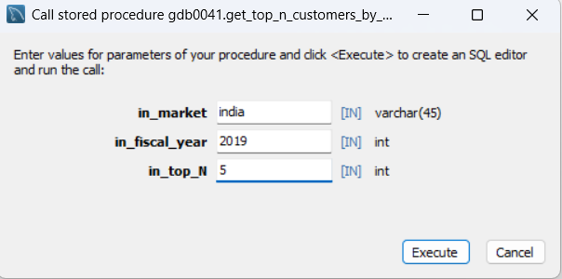
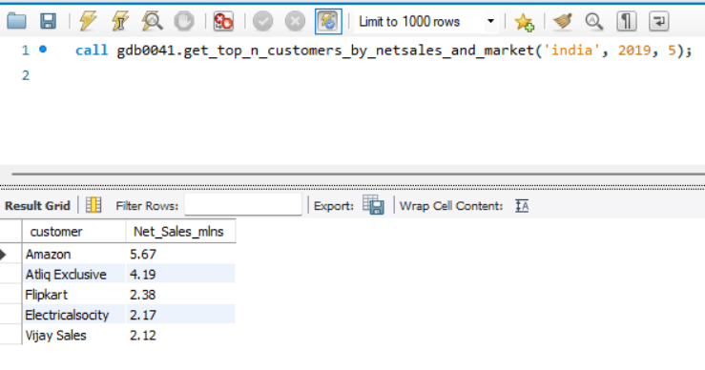
Solution pictures

Slide 13
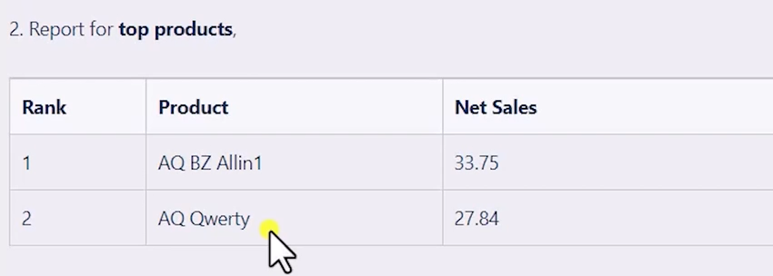
FINANCE ANALYTICS
TASK 4: TOP PRODUCTS
Created A Stored Procedure to automate repeated tasks
Built after creating the Net Sales view, which was optimized using pre-invoice and post-invoice discount views to reduce query time.
This stored procedure helps analyze top-performing Products in a specific fiscal year, based on their Net Sales.
Purpose
  To display the Top N Products in a selected fiscal year, ranked by their Net Sales value.
Inputs
  in_fiscal_year → Fiscal year to filter the data.
  in_top_N → Number of top products to return
Logic
  Selects Product name and the sum of net sales from the net_sales view.
  Converts net sales into millions and rounds to 2 decimal places for readability.
  Filters records by the given fiscal year.
  Groups data by Product to calculate total sales per product.
  Orders results in descending order of Net Sales.
  Limits the output to the Top N Products as specified by the input parameter.
Output
  Displays the Top N Products with their Net Sales (in millions) for the selected Fiscal Year, enabling quick performance comparison across products.
Retrieves sales data for customer 90002002 in fiscal year 2021, showing product name, variant, sold quantity, gross price, and total gross price.
Joins fact_sales_monthly, dim_product, and fact_gross_price tables using product_code and fiscal_year.
Uses the get_fiscal_year() function to extract the fiscal year from the sale date for accurate price matching.
Calculates Total_Gross_Price as (sold_quantity × gross_price).
Filters results by customer_code and fiscal_year, sorts by date (ascending), and limits output to 1,000,000 records.

Slide 14
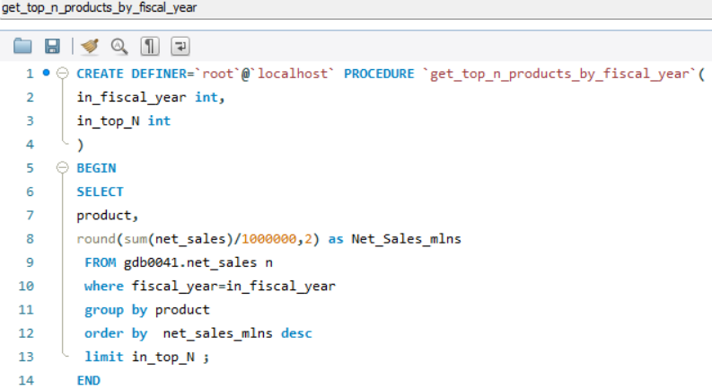
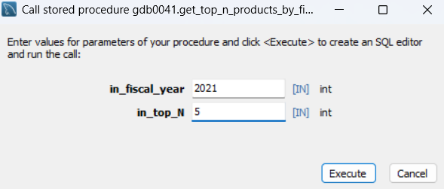
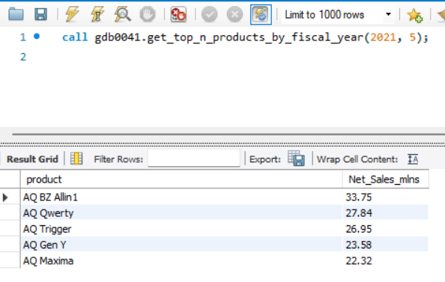
Solution pictures

Slide 15
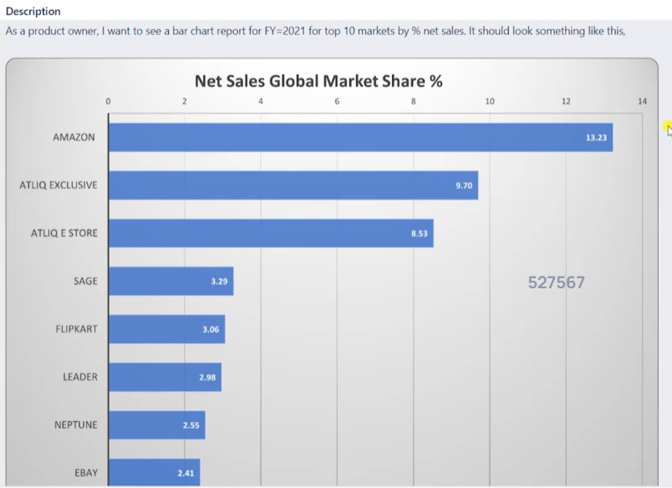
FINANCE ANALYTICS
TASK 5
The query finds the Top 10 customers based on Net Sales for the fiscal year 2021.
A CTE (Common Table Expression) named cte1 first calculates total Net Sales (in millions) per customer.
The main query uses a window function - SUM(Net_Sales_mlns) OVER() - to calculate the percentage contribution of each customer’s sales to total sales.
It then computes a new column Net_pct showing each customer’s share in total sales.
Finally, results are sorted by Net Sales (descending) and limited to the top 10 customers.
The output was exported to CSV and visualized as a horizontal bar chart to meet the analysis requirement..
Retrieves sales data for customer 90002002 in fiscal year 2021, showing product name, variant, sold quantity, gross price, and total gross price.
Joins fact_sales_monthly, dim_product, and fact_gross_price tables using product_code and fiscal_year.
Uses the get_fiscal_year() function to extract the fiscal year from the sale date for accurate price matching.
Calculates Total_Gross_Price as (sold_quantity × gross_price).
Filters results by customer_code and fiscal_year, sorts by date (ascending), and limits output to 1,000,000 records.

Slide 16
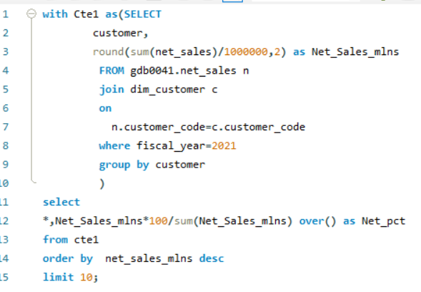
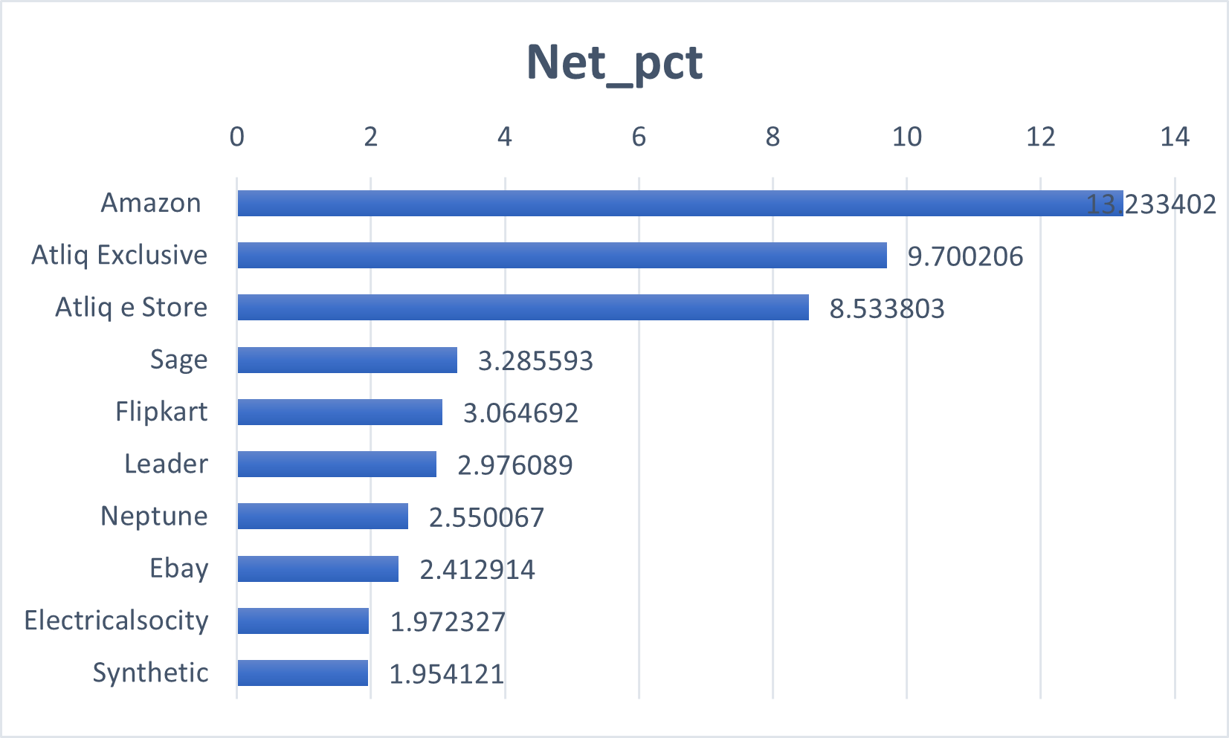
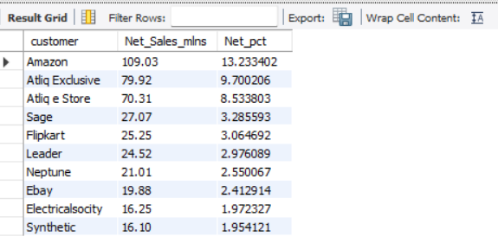
Solution pictures

Slide 17
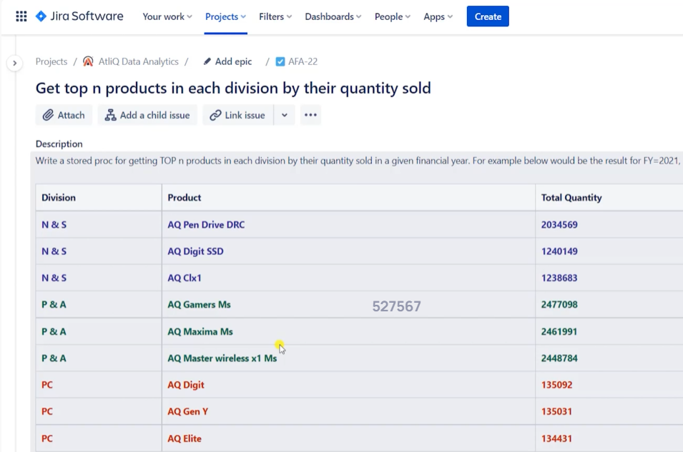
FINANCE ANALYTICS
TASK 6
Purpose: This stored procedure, top_3products_by_sold_quantity_in_each_division, returns the top N products by sold quantity in each division for a given fiscal year.
Inputs: Takes two parameters — in_fiscal_year (year filter) and in_rank (top rank limit, e.g., 3).
CTE1: Calculates the total sold quantity of each product within every division for the given fiscal year
CTE2: Assigns a DENSE_RANK() to products within each division based on their total sold quantity in descending order.
Final Output: Filters and displays only those products whose rank is less than or equal to the input rank (e.g., Top 3).
Use Case: Helps analyze best-selling products by division to support sales and inventory decisions.
Retrieves sales data for customer 90002002 in fiscal year 2021, showing product name, variant, sold quantity, gross price, and total gross price.
Joins fact_sales_monthly, dim_product, and fact_gross_price tables using product_code and fiscal_year.
Uses the get_fiscal_year() function to extract the fiscal year from the sale date for accurate price matching.
Calculates Total_Gross_Price as (sold_quantity × gross_price).
Filters results by customer_code and fiscal_year, sorts by date (ascending), and limits output to 1,000,000 records.

Slide 18
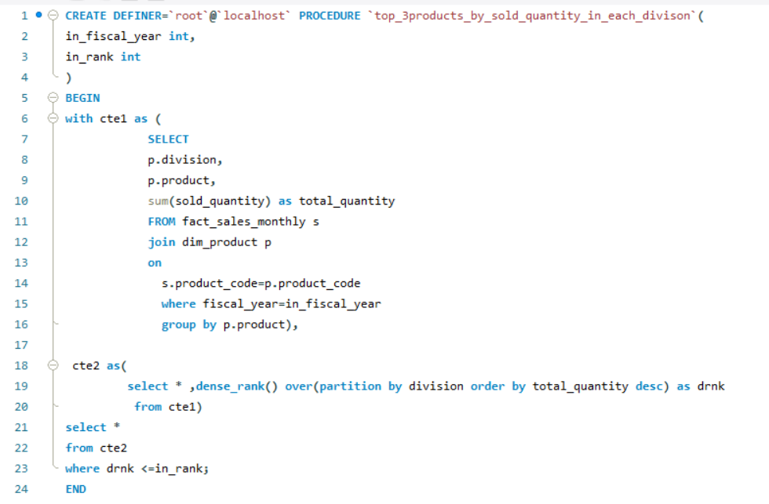
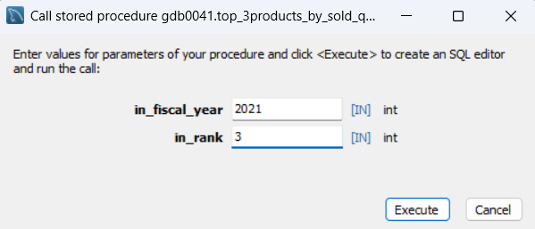
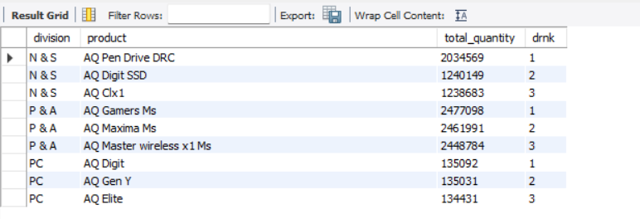
Solution pictures

Slide 19
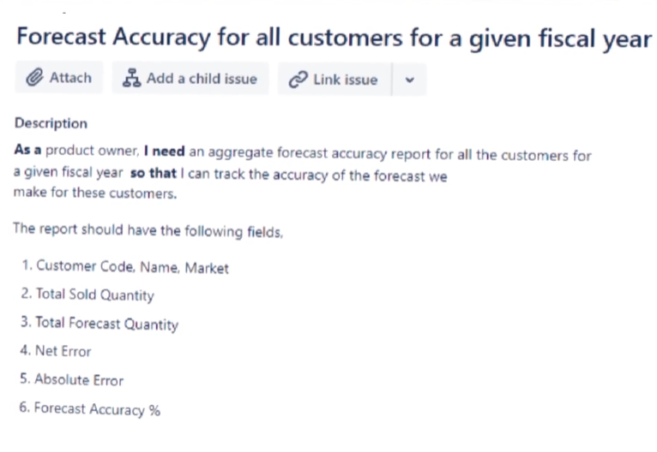
Supply chain analytics
TASK 7
Step 1: A helper table named fact_act_est was created by joining fact_sales_monthly (actual sales) and fact_forecast_monthly (forecasted sales) to compare actual vs predicted quantities.
Step 2: The stored procedure get_forecast_accuracy calculates the accuracy of sales forecasts for a given fiscal year.
CTE (forecast_err_table): Summarises total sold and forecast quantities per customer and computes metrics like net error, absolute error, and their percentage deviations.
Main Query: Joins results with dim_customer to display customer names and markets.
Forecast Accuracy Formula:
Forecast Accuracy = 100 - Absolute Error % (values above 100 are adjusted to 0).
Output: Lists customers with their forecast accuracy, sorted in descending order to identify the most accurate forecasts.
Use Case: Helps evaluate forecast performance and improve demand planning accuracy.
Retrieves sales data for customer 90002002 in fiscal year 2021, showing product name, variant, sold quantity, gross price, and total gross price.
Joins fact_sales_monthly, dim_product, and fact_gross_price tables using product_code and fiscal_year.
Uses the get_fiscal_year() function to extract the fiscal year from the sale date for accurate price matching.
Calculates Total_Gross_Price as (sold_quantity × gross_price).
Filters results by customer_code and fiscal_year, sorts by date (ascending), and limits output to 1,000,000 records.

Slide 20
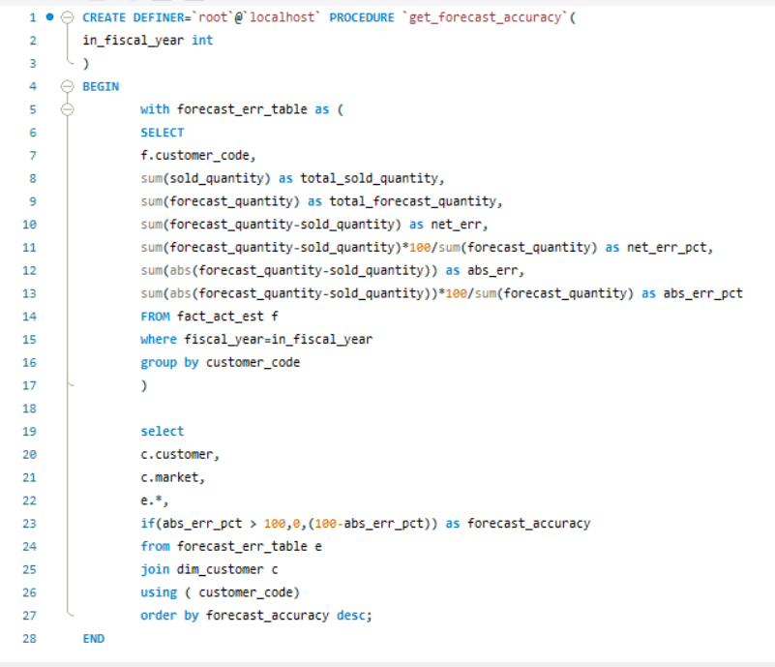
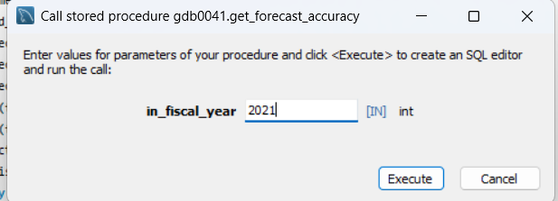
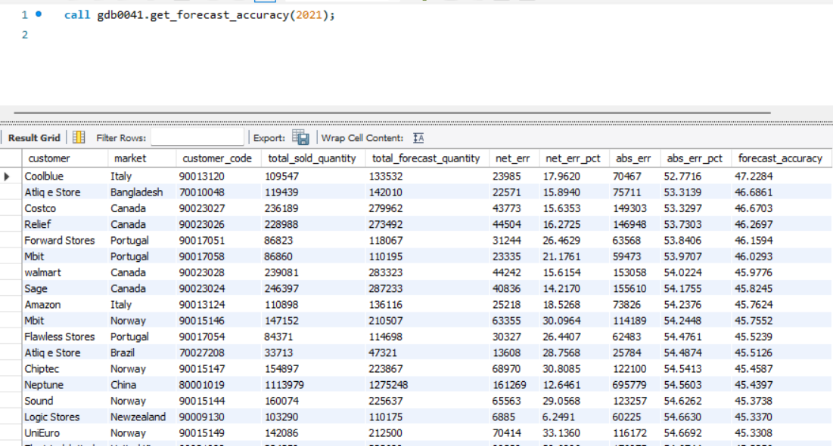
Solution pictures

